Slide 1
Project Tutorial Session
Ankita Rajaram Naik

Slide 2
Objectives
Milestone Report
Wandb - Python Package to record experiments
Debugging your model
Model Inputs
Model Architecture
Model Outputs

Slide 3
Milestone Report Expectations
You have explored your dataset to identify it's nuances
Have a dataloader for ingesting the data in your model
You have a baseline model running on the dataloader
You have preliminary results from the baseline model

Slide 4
Milestone Report
Problem Statement
Describe your problem precisely specifying the dataset to be used, expected results and evaluation.
Use techniques mentioned in EDA section of this notebook to populate statistics about your dataset and draw conclusions based on the same

Slide 5
Milestone Report
Technical Approach
Broadly project ideas are divided into:
1) Starting from a Pre-trained Model and making improvements
Describe the pre-trained model using diagrams
Mention its shortcomings you are working on (if any)
Baseline Model : The pre-trained model is the baseline model
2) Setting up a model yourself
Describe the model architecture, objective function and loss function
Baseline : Models like SVM, 3-layer neural network, RNN, etc. taught in class
3) Starting from a github repository of model and making improvements
Describe the github model using diagrams
Mention its shortcomings you are working on (if any)
Baseline Model : Could be any model taught in class or the github repository model if you already have a trained version of the github repository model

Slide 6
Milestone Report
Intermediate/Preliminary Results
1) Starting from Pre-trained Models
Experiments on a subset of the dataset
Error Analysis on preliminary results
2) Setting up a model / starting from a github repo
Setup the architecture / github repo on a subset of the dataset
Ensure loss is reducing
Overfitting Experiments on your framework
These could be produced and stored in Wandb directly from your code. This would be covered in the model analysis section.

Slide 7
Wandb
Creating graphs for your milestone report on the fly!

Slide 8
Standard Model Nuances
Overfitting experiments not working
Performance is not good
Performance is not good even for pretrained models
Loss / gradients / weights are NaNs, Inf or zero
Model convergence time is high

Slide 9
Standard Model Nuances
01
Model Input
Data Nuances
Parameter Initialization Errors
02
Model Architecture
Non compatible loss or objective function
Exploding / Vanishing gradients
Coding Errors!!
03
Model Output
Incorrect evaluation metric used

Slide 10
Model has recall of 98% and accuracy of 95% after training
What do you think is the nuance?
Imbalanced Classes
Solutions
Undersample majority class or oversample minority class
Large Kaggle Datasets - Stratified Sampling
Exploratory Analysis and recording basic statistics of the dataset is necessary.

Slide 11
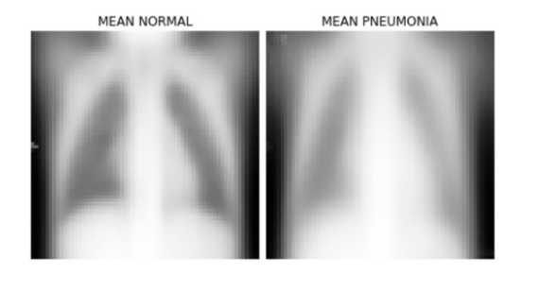
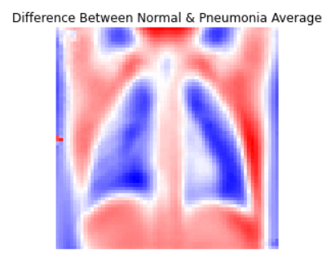
Basic Data Statistics
Number of Train, Validation, Test examples
Number of examples per class
Balance Imbalanced classes
Outliers of the dataset based on mean /median
Hazy images, corrupted text could be removed
Per class outliers
Mean / standard deviation per class
Statistics for augmented vs non-augmented images

Slide 12
Model Architecture Nuances
Coding Errors
Loss Errors
Gradient Errors

Slide 13
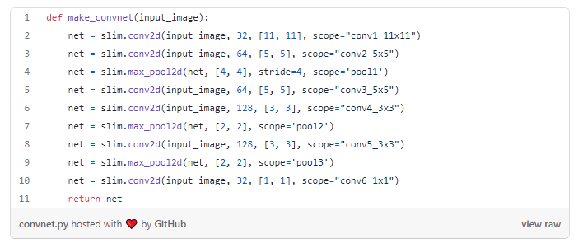
Model Architecture Nuances - Coding Errors

Slide 14
Model Architecture Nuances - Coding Errors

Slide 15
Model Architecture Nuances - Coding Errors
This code never crashes, raises an error, or even slows down.
This network still trains and the loss will still go down.
The values converge after a few hours, but to really poor results
Check for parameter updates between layers when running the first experiment

Slide 16
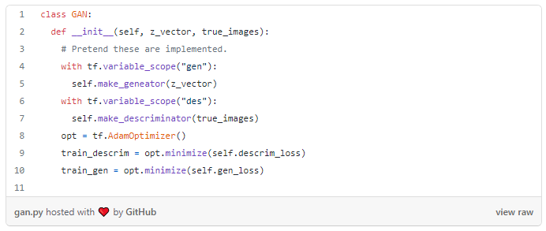
Pre-trained Models
Ensure which all parameters are being updated (i.e. check gradients at the end of the backward pass)

Slide 17
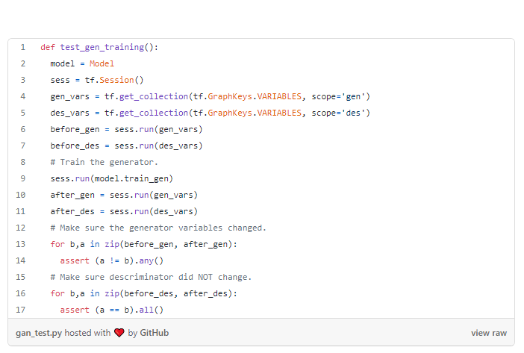
Pre-trained Models
Lead to increased training time!
Check for which all parameters have gradients when running the first experiment

Slide 18
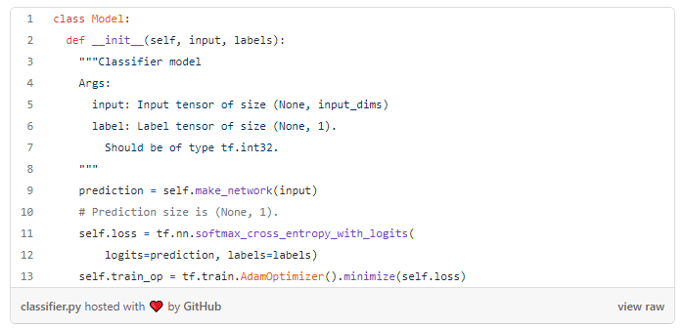
Model Architecture Nuances - Loss Errors
Loss is always zero

Slide 19
Model Architecture Nuances - Loss Errors
Loss is always zero

Slide 20
Model Architecture Nuances - Loss Errors
Confirm appropriate loss is being used
Use metric like F1-measure for imbalance classification problems
Verify loss at initialization
Overfit on small datasets
If model has high number of parameters overfitting may take time
Verify decreasing training loss
Add regularization

Slide 21
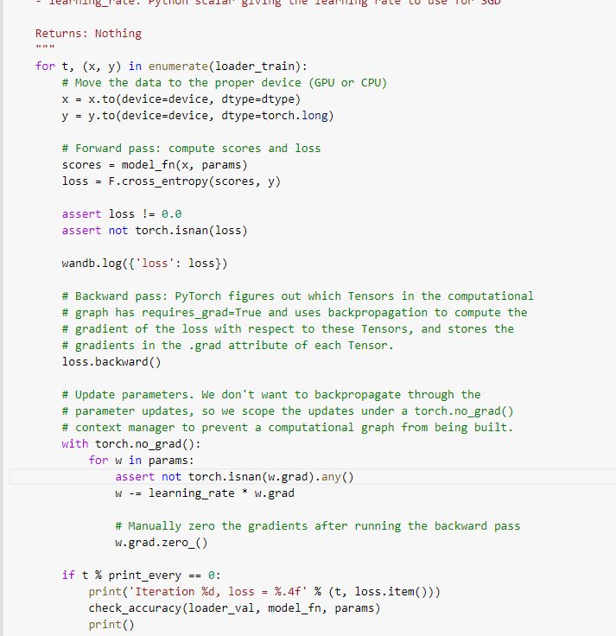
Model Architecture - Gradient
Add “assert” statements
Detect Grad anomalies
torch.autograd.detect_anomaly()
Gradient scaling
Gradient clipping
torch.nn.utils.clip_grad_norm_(model.parameters(), max_grad_norm)

Slide 22
Model Debugging Summary
Start Simple - Build a baseline model and complete an overfitting experiment
Confirm your loss
Check intermediate outputs and connections
Check gradients and gradient updates
Diagnose hyperparameters used - Learning rate, batch size, filter size
Track your experiments

Slide 23
References
Torchtest - PyTorch Model Debugging
Mltest - Tensorflow Model Debugging
Debugging Neural Networks with PyTorch and W&B
Checklist for debugging neural networks
How to unit test machine learning code
A Recipe to training Neural Networks

